Slide 1

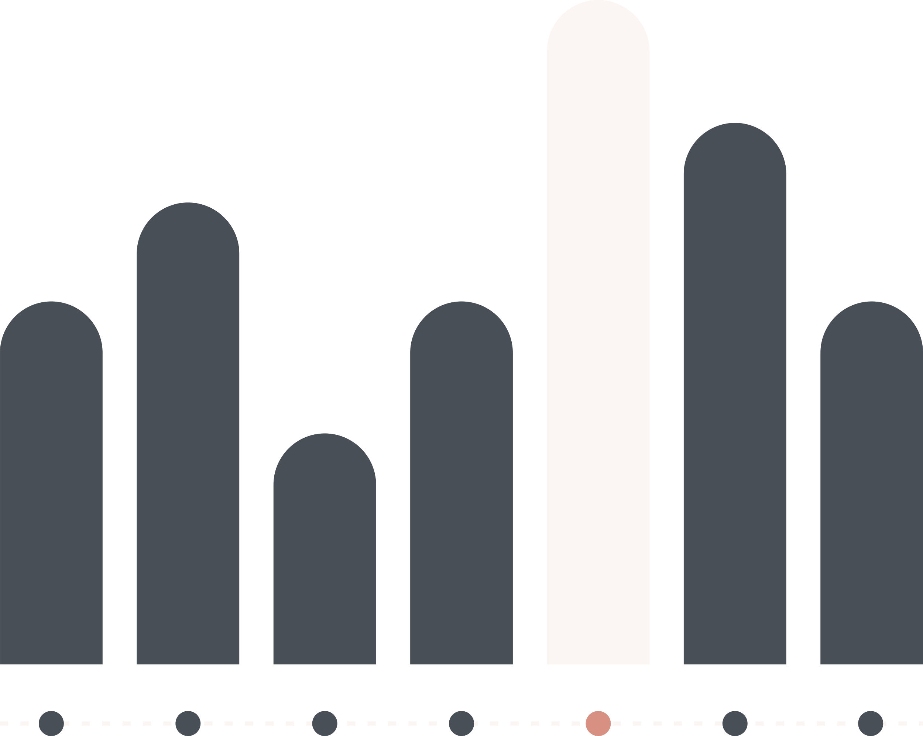

R DATA ANALYST
EDA: Students Performance in Exams

Slide 2






Group members
Ngô Văn Khánh
Lê Tuấn Nghĩa
Trần Minh Duy
Cao Trọng Nghĩa
1
2
3
4

Slide 3
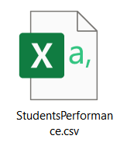
PROJECT INFORMATION
Objective
After the R analysis course, our team conducted an analysis of a dataset of Marks secured by the students in high school
Students from the United States.
To understand the how the student's performance (test scores) is affected by the other variables (Gender, Ethnicity, Parental level of education, Lunch, Test preparation course)
Datasource: StudentsPerformance.csv
After analyzing, we find out the problem of the group's questions and
offer suitable methods for students to improve the quality of learning and education.
https://www.kaggle.com/datasets/spscientist/students- performance-in-exams
https://www.kaggle.com/datasets/spscientist/students- performance-in-exams

Slide 4
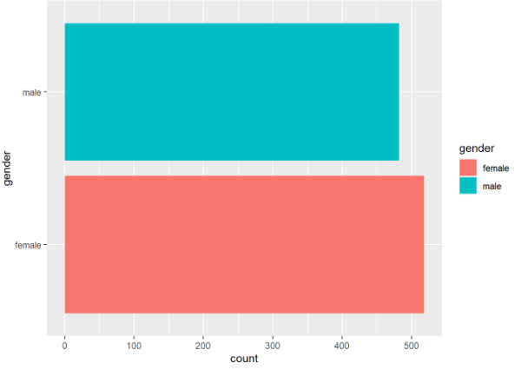
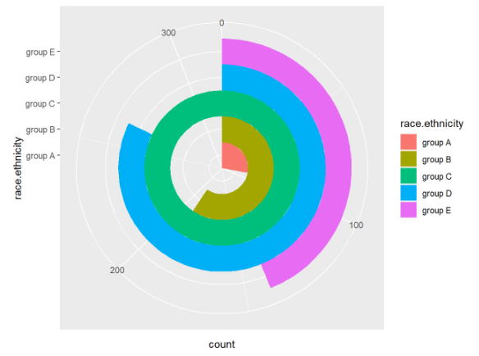
Statistics of all variables in the data file and shows the difference between groups
+ For `gender` there is no significant difference
+ For `race.ethnicity`, `parental_level_of_education`, `lunch`, `test_preparation_course` there are significant differences, it is easy to see how unequal the division of groups in the same variable.
-> So, does that really affect the student's final result?
(EDA)

Slide 5
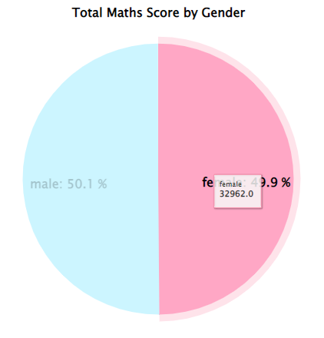
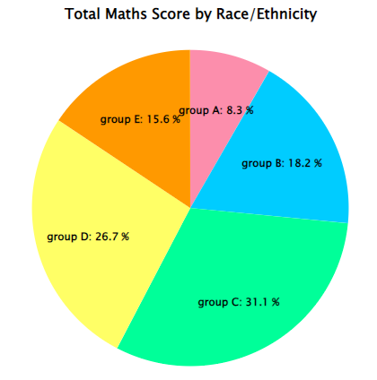
2. Analyze the factors that affect performance? What are the most influential factors?
- After showing the correlation between the environment variables and the outcome variables, we can see the difference in the results achieved in different groups in the same variable.
However,..... ?
(EDA)

Slide 6
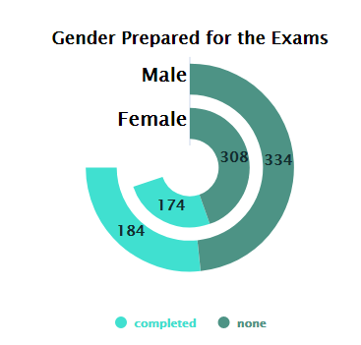
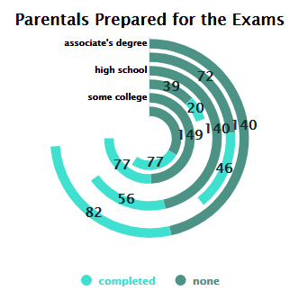
3. What is the relationship between variables other than test_preparation_course in the dataset?
- After statistics, we can easily see that the variable 'gender' does not have much impact on the number of observations because the difference between 'male' and 'female' is not much.
- However, for different variables such as `race.ethnicity`, `lunch`, `parental_level_of_education`, there is a clear distinction between the data fields, the difference is large. Thus, we can conclude that the variables: `race.ethnicity`, `lunch`, `parental_level_of_education` are the cause of the heterogeneity of the variable `test_preparation_course`.
(EDA)

Slide 7
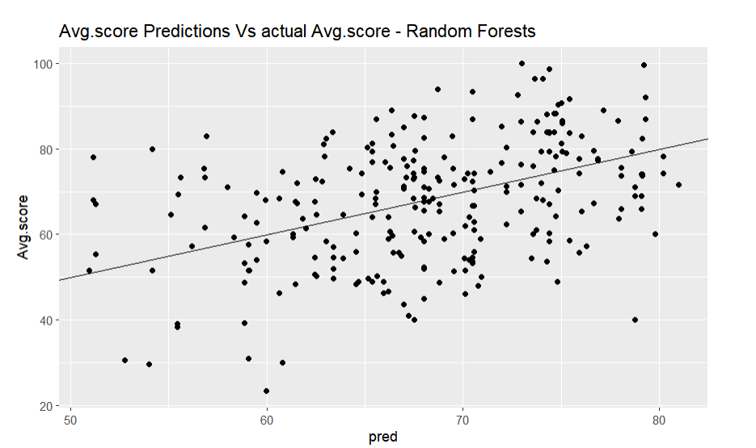
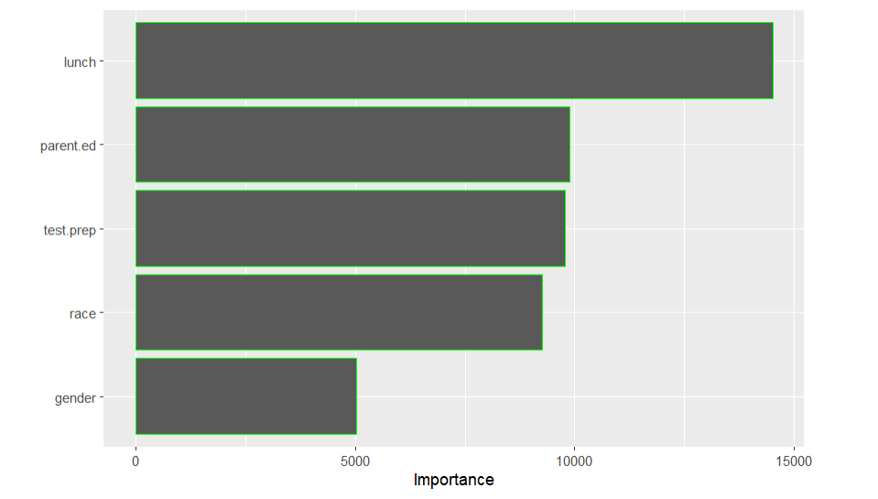
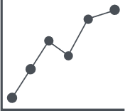
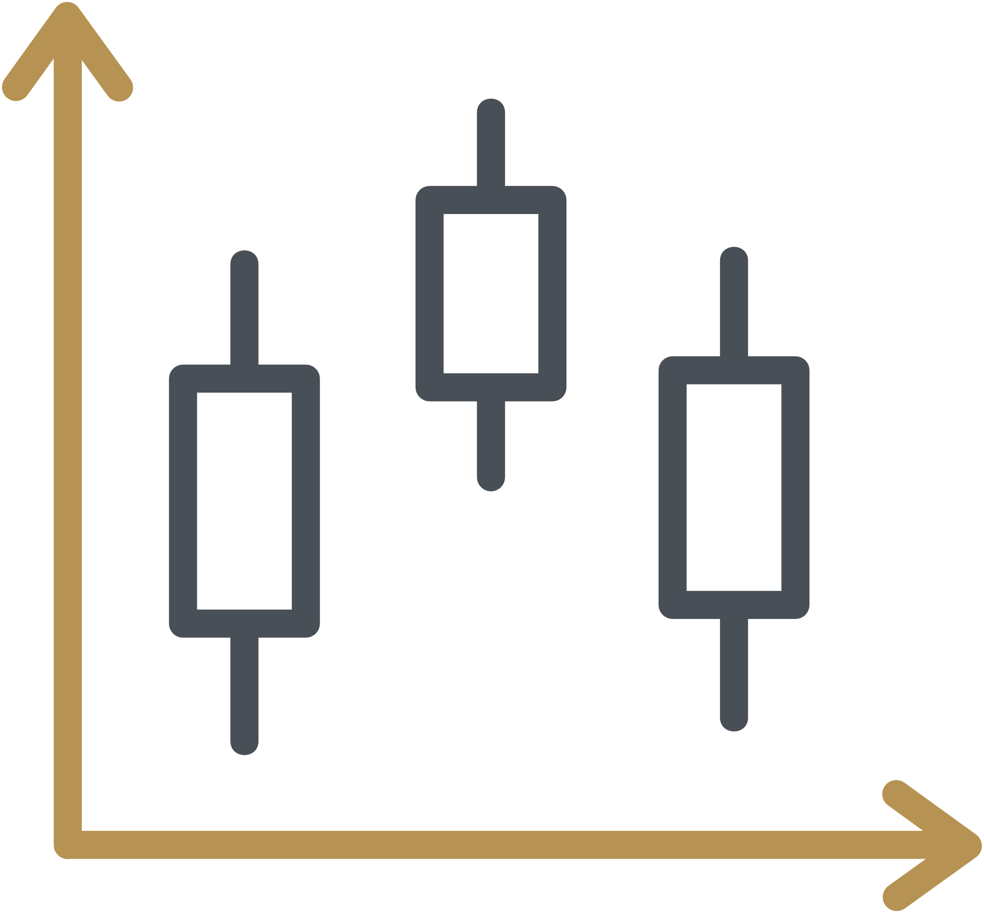

TECHNIQUES AND ANALYTICAL MODEL - MACHINE LEARNING
Train to Find the most important variable
Summarizing, analyzing by RF
(train and test) gives the
most important result that
Luch variable is the
most important
PREDICTION USING RANDOM FOREST MODEL
library(randomForest)
train/test
making prediction on the student_test
calculating RMSE of the predictions
show the Graph Avg.score Predictions vs actual
Avg.score - Random Forests
attaching package: ‘vip’ and show graph to find
the most important variables

Slide 8
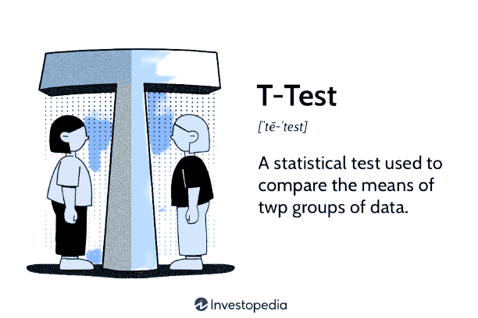
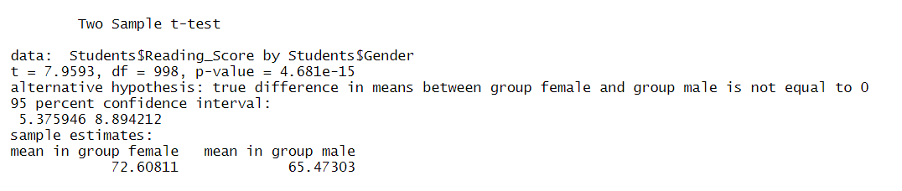
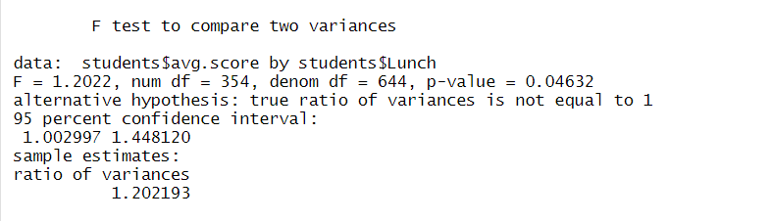
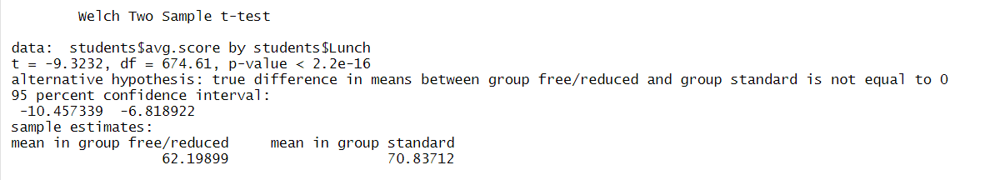
T-Test
Hypothesize
H0: True
H1: False
P-value
deny hypothesis H0 (if P < 5%)
In this project, we use three type of t-test
accept hypothesis H0 (if P > 5%)
Two Sample t-test
Welch Two Sample t-test
95 percent confidence interval
Standard deviation
Alternative hypothesis
F test to compare two variances

Slide 9
PREDICTION USING MULTIPLE LINEAR REGRESSION
using library caret
make the prediction of total score from data
calculating RMSE of the predictions to evaluate the performance of the model
show the plot of Total score Predictions vs actual
Total score

Slide 10
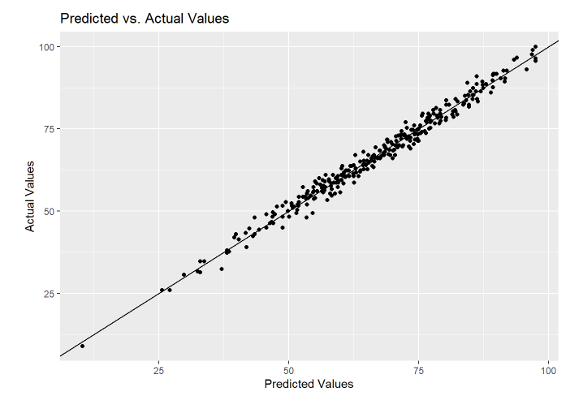
Through observation from the
chart above, we see that the
predicted results from Multiple
Regression are quite close
to reality.

Slide 11
Analysis using of Variance (ANOVA)
using library(naniar)
make the prediction of math score avg from
data
calculate p (confidence interval) to evaluate
the model
Draw conclusions based on p (confidence
interval)

Slide 12
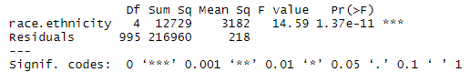
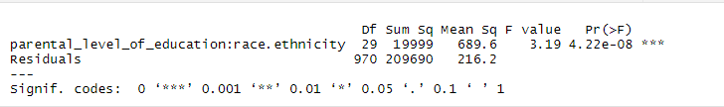
Through observation from
With these two models, we find that the results of the analysis of variance (ANOVA) are quite accurate compared to the reality.

Slide 13





CONCLUSION
Through two models used to predict scores, Linear Regression model and Random Forest model...
However, to be able to predict accurately...
01
03
05
Through data visualization, we can see the factors...
After the group study, I found that there are a number of factors that affect students' scores,...
If given more time, the Team will....
02
04

